Slide 1
Measurement of Energy in Food and During Physical Activity

Slide 2
Objectives
Describe how food energy is measured
Compare and contrast direct and indirect calorimetry
List the Atwater factors for carbohydrates, protein, and lipid
Define respiratory quotient (RQ) and list the RQ values for carbohydrates, protein, and fat
Define basal metabolic rate, total daily energy expenditure, and the metabolic equivalent (MET)

Slide 3
Units of energy measurement
Calorie
One Calorie expresses the quantity of heat necessary to raise the temperature of 1kg 1L of water by 1 degree cesius
Kilocalorie (kcal)
More accurately defines calorie
Kilojoule
Standard international unit for expressing energy
Megajoule
Equal to 1000 kj
Notes:
The calorie is a unit of energy measurement.
Kilocalorie (kCal) more accurately defines calorie.
Kilojoule: standard international unit for expressing energy
Megajoule: 1000 kj

Slide 4

Basic definitions for this chapter
Temperature:
A quantitative measure of an object’s hotness or coldness
Heat:
The energy transfer from one body or system to another

Slide 5
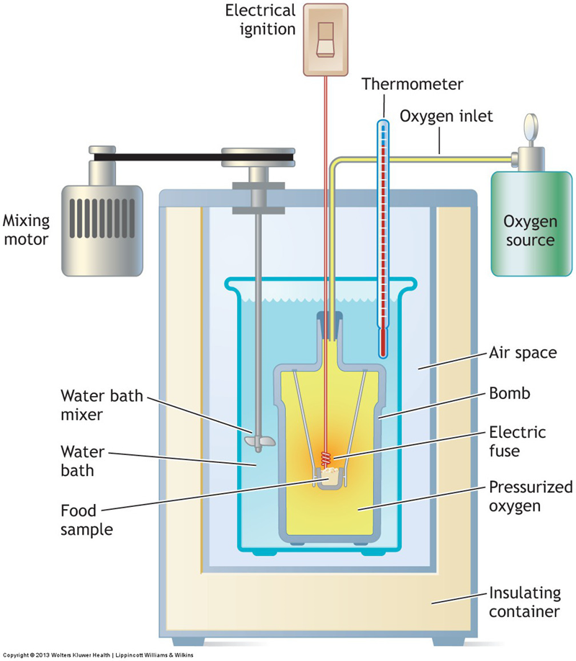
Bomb calorimeter
Measures total energy value of foods
Type of direct calorimetry
Increase in water temperature directly reflects the heat released
Heat of combustion
Notes:
Heat of combustion refers to the heat liberated by oxidizing a specific food; it represents the food’s total energy value.

Slide 6
Heat of combustion
The heat liberated by oxidizing a specific food (total energy value)
Carbohydrates
4.2 kcal
Lipids
9.4 kcal
Proteins
5.56
Notes:
The heat of combustion for carbohydrate varies depending on the arrangement of atoms in the particular carbohydrate molecule.
The heat of combustion for lipid varies with the structural composition of the triacylglycerol molecule’s fatty acid components.
Two factors affect energy release from protein combustion: (1) type of protein in the food and (2) relative nitrogen content of the protein.

Slide 7
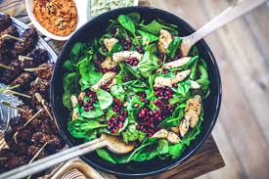
Net energy value of foods
Actual energy available to the body
Coefficient of digestibility
affected by dietary fiber
Atwater general factors
Carbohydrates | 4 kcal/g
Lipid | 9 kcal/g
Protein | 4 kcal/g
Notes:
Dietary fiber reduces the coefficient of digestibility: A high-fiber meal has less total energy absorbed than does a fiber-free meal of equivalent caloric content.
Considerable variability exists in efficiency percentages for any food within a particular category.

Slide 8
Measurement of Human Energy Expenditure

Slide 9
Direct calorimetry
Directly measures energy metabolism heat production
Human calorimeter
Airtight chamber
Changes in water temperature relate directly to an individual’s energy metabolism
Notes:
A known water volume at a specified temperature circulates through a series of coils at the top of the chamber. This water absorbs the heat produced and radiated by the individual while in the calorimeter.
For adequate ventilation, the person’s exhaled air continually passes from the room through chemicals that remove moisture and absorb carbon dioxide. Oxygen added to the air recirculates through the chamber.

Slide 10
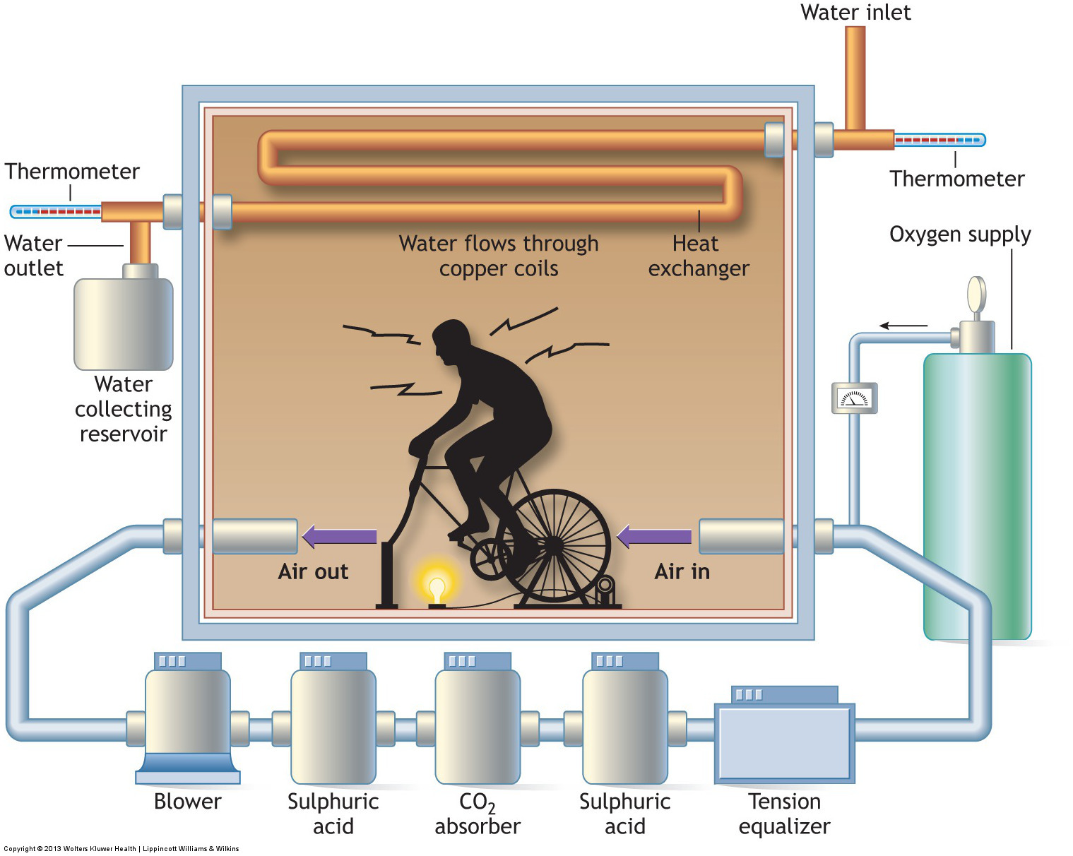

Slide 11
Indirect calorimetry
measures oxygen uptake to provide an accurate estimate of energy expenditure
Five common indirect calorimetry methods to measure O2 uptake:
Portable spirometry
Bag technique
Ventilated hood technique
Computerized instrumentation
Doubly labeled water technique*

Slide 12
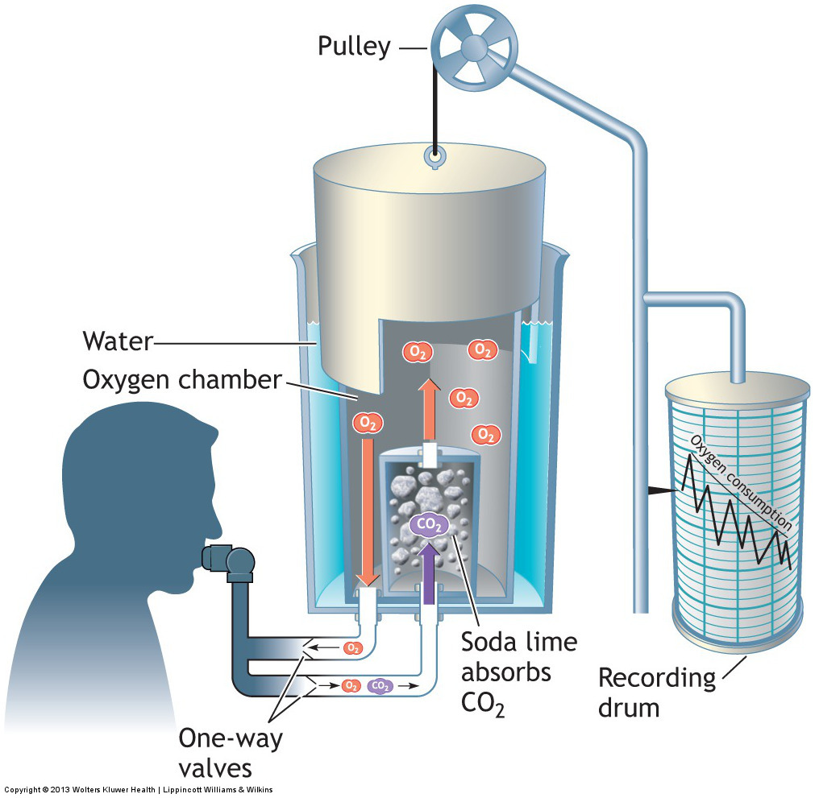

Slide 13
Indirect calorimetry, continued
Doubly labeled water technique
Provides a useful way to estimate total daily energy expenditure in free-living conditions
Expensive
Provides an ideal way to assess total energy expenditure of groups over prolonged time periods
Notes:
Does not have the normal constraints imposed by other indirect procedures.

Slide 14
The respiratory quotient (RQ)
The ration of carbon dioxide produced to oxygen consumed
The RQ provides information about the nutrient mixture catabolized for energy
R Q values:
1.00 for carbohydrates
0.70 for fat
0.82 for protein
Notes:
The RQ provides a convenient guide to approximate the nutrient mixture catabolized for energy during rest and aerobic exercise.

Slide 15
The respiratory exchange ratio
Computes in exactly the same manner as RQ
R > 1.00
Overbreathing
Exhaustive exercise
R < 0.70
After exhaustive exercise

Slide 16
Energy expenditure during rest and physical activity
Three factors determine total daily energy expenditure:
Resting metabolic rate
Thermogenic influence of food consumed
Energy expended during physical activity and recovery
Notes:
Resting metabolic rates includes basal and sleeping conditions.

Slide 17
Basal metabolic rate (BMR)
Minimum energy requirement to sustain the body’s functions
Establishes an energy baseline
Lover in women compared with men why?
Lean body mass is lower and fat proportion is higher
Notes:
BMR averages 5–10% lower in females compared with males at all ages.

Slide 18

Total daily energy expenditure (TDEE)
Influenced by
Physical activity
Diet induced thermogenesis
Climate
pregnancy
Notes:
The resting metabolism of people who live in tropical climates, for example, averages 5–20% higher than counterparts in more temperate regions.
As pregnancy progresses, increases in maternal body weight add considerably to exercise effort during weight-bearing walking, jogging, and stair climbing and may also reduce the economy of physical effort.

Slide 19
The metabolic equivalent (MET)
1 MET represents an adult’s average seated, resting oxygen consumption or energy expenditure
Met provides a convenient way to rate exercise intensity with respect to a resting baseline
1 MET = ml[02] * kg^-1 * min ^ -1

